Slide 1
DIY Electronics: The Game of Simon using the Arudino
Ryan Brock

Slide 2
About Me
Ryan Brock
Software Engineer – 14 Years
Purdue University – Computer Science
Motorola
Zebra Technologies

Slide 3
Contact
Twitter: @borq79
Email: borq79@gmail.com
Github Repo:
https://github.com/borq79/Cary-Area-Public-Library-Classes

Slide 4
Agenda
Intro
Wire up Project
Arduino Sketch Basics
WS2811
Buttons and Pullup Resistors
Piezo and tone()
Game Time!

Slide 5
Your Kits
$55 Vilros Ultimate Starter Kit
https://www.vilros.com/ultimate-starter-kit.html
$8 LED Strip
http://www.amazon.com/NulSom-NeoPixel-Rainbow-Stick-Arduino/dp/B00PTEP14W/ref=sr_1_1?ie=UTF8&qid=1452991973&sr=8-1&keywords=neopixel+stick
$3 20 pc. Capacitor Pack
http://www.dx.com/p/16v-1000uf-aluminum-motherboard-capacitors-20-piece-pack-127865#.V0IQv5MrJMM
50 Button Pack
https://www.amazon.com/gp/product/B00R17XUFC/ref=oh_aui_search_detailpage?ie=UTF8&psc=1

Slide 6

The Arduino Uno

Slide 7
Breadboard
Where is C:19?

Slide 8

Just Like Battleship

Slide 9
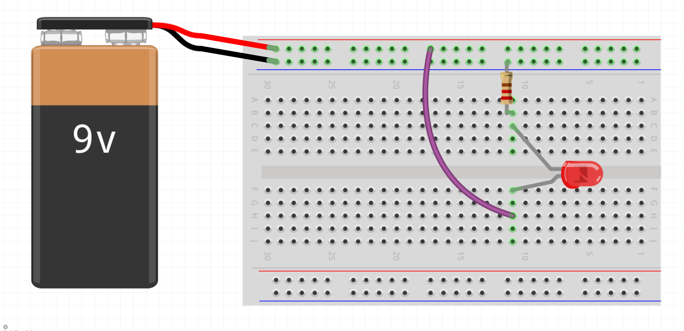
Wiring up a Circuit

Slide 10
Project Parts List
Arduino
Breadboard
USB Cable
1 Neo Pixel Strip with 8 LEDs
1 1000F Capacitor
1 10K Ohm resistor
3 Male-Female wires
12 Short Male-Male wires
4 small buttons (not the bigger ones)
1 Piezo Speaker

Slide 11
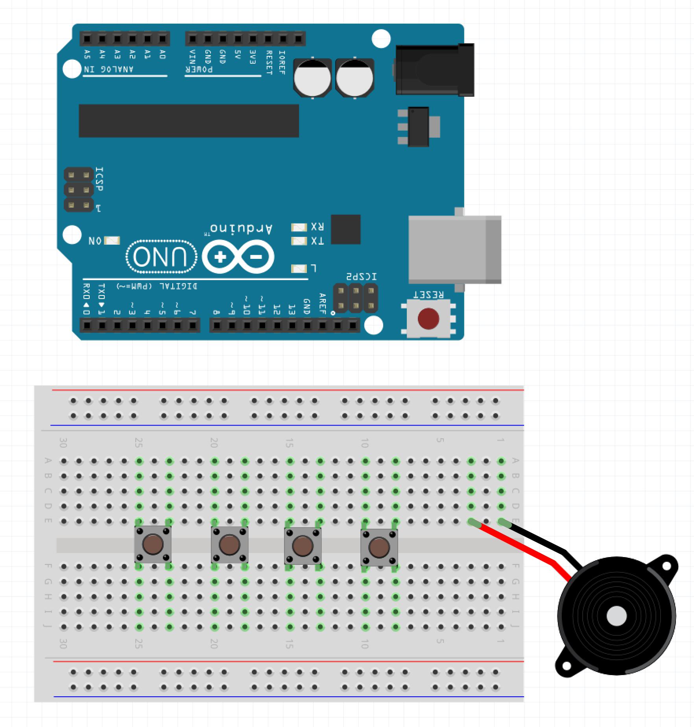
Step 1 – Place the Buttons and Speaker
Make sure the USB Cable is not plugged into the PC
Place the four buttons – Place the upper left corners in E:25, E:20, E:15, and E:10
Place the Piezo so that the + is in E:3 and the – is in E:1 (the piezo you have will not look like the diagram – it will sit directly on the board)

Slide 12
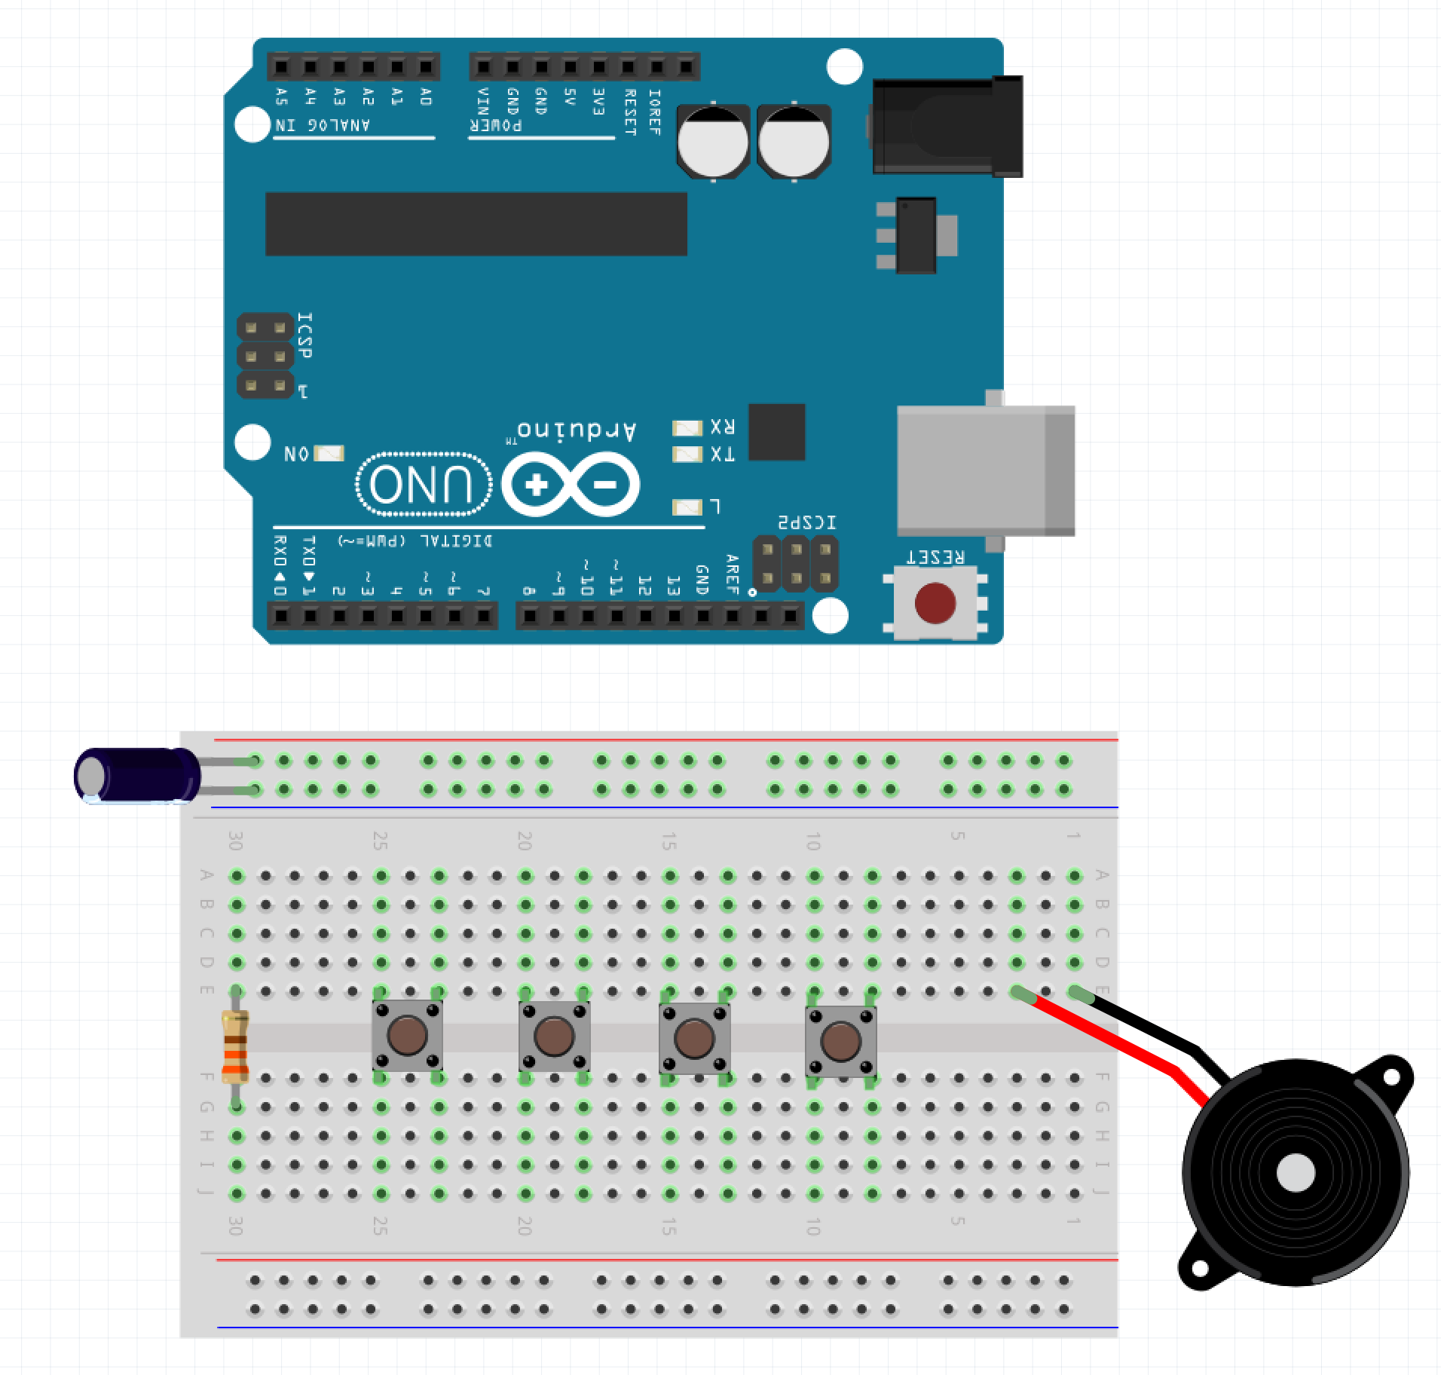
Step 2 – Place WS2811 Components
Place the + (longer leg) of the capacitor into the top red row
Place the shorter leg of the capacitor (also the side painted gray) in the top blue row
Place the one leg of the resistor in E:30 and the other leg into F:30

Slide 13
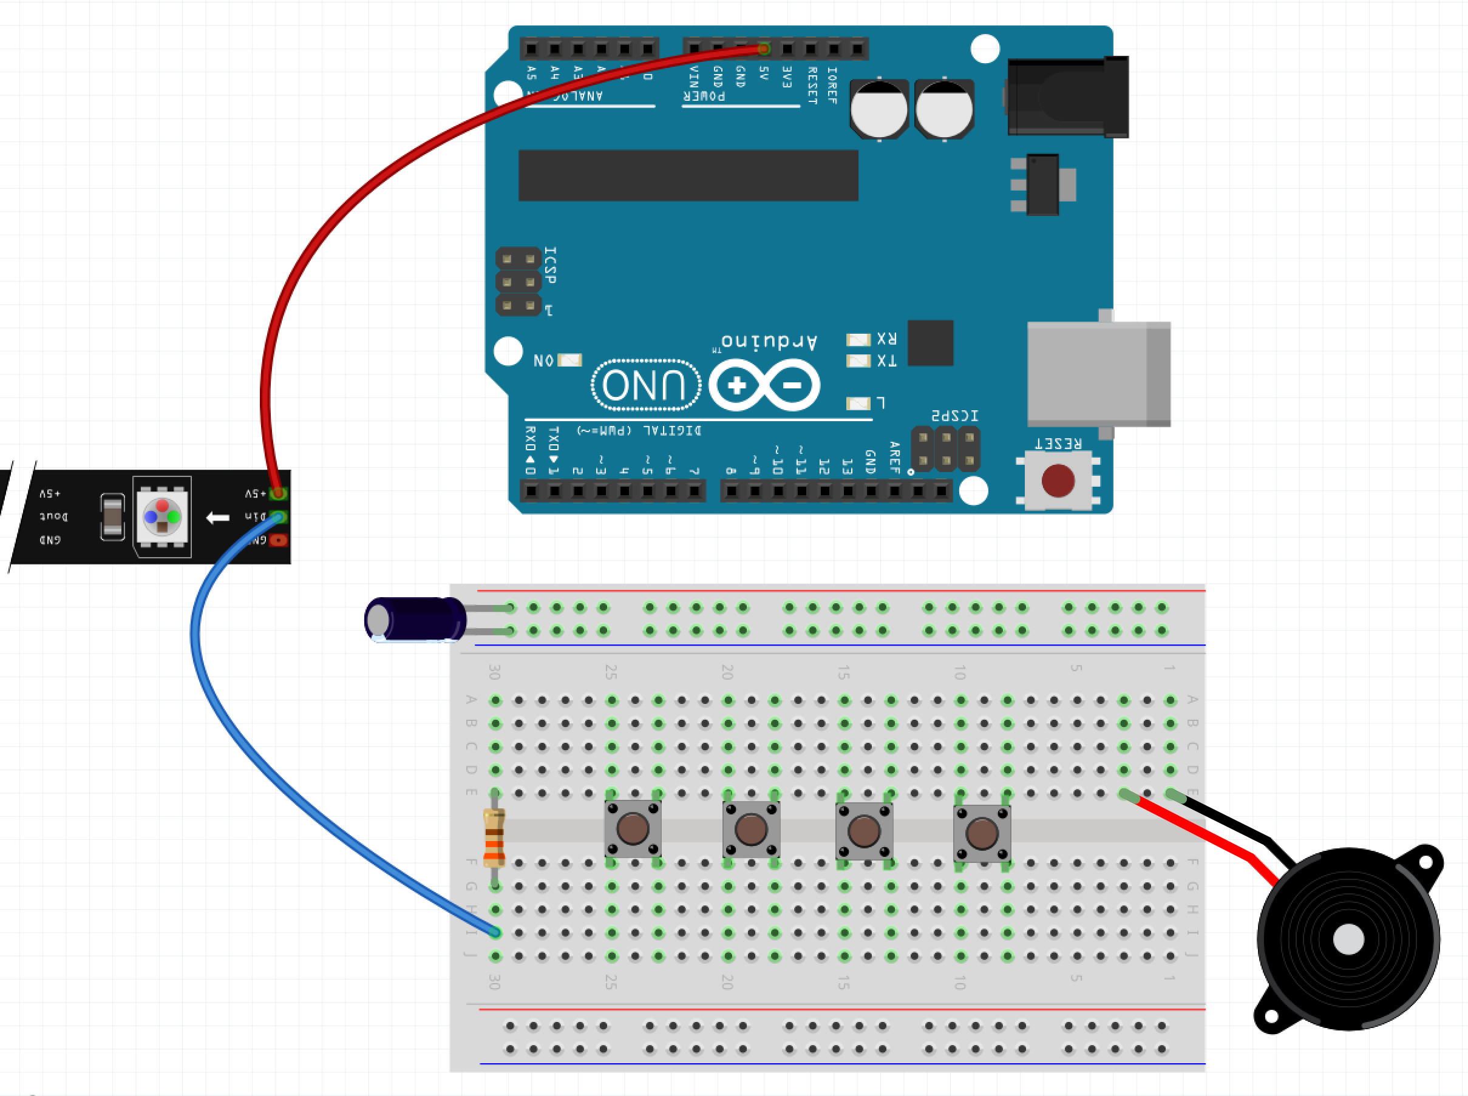
Step 3 – Start to Wire Up WS2811
Attach the female end of a female-male wire onto the 5V pin of the WS2811 – attach the male end into the 5V of the Arduino
Attach the female end of a female-male wire onto the DIn pin of the WS2811 – attach the male end into the I:30 of the Breadboard

Slide 14
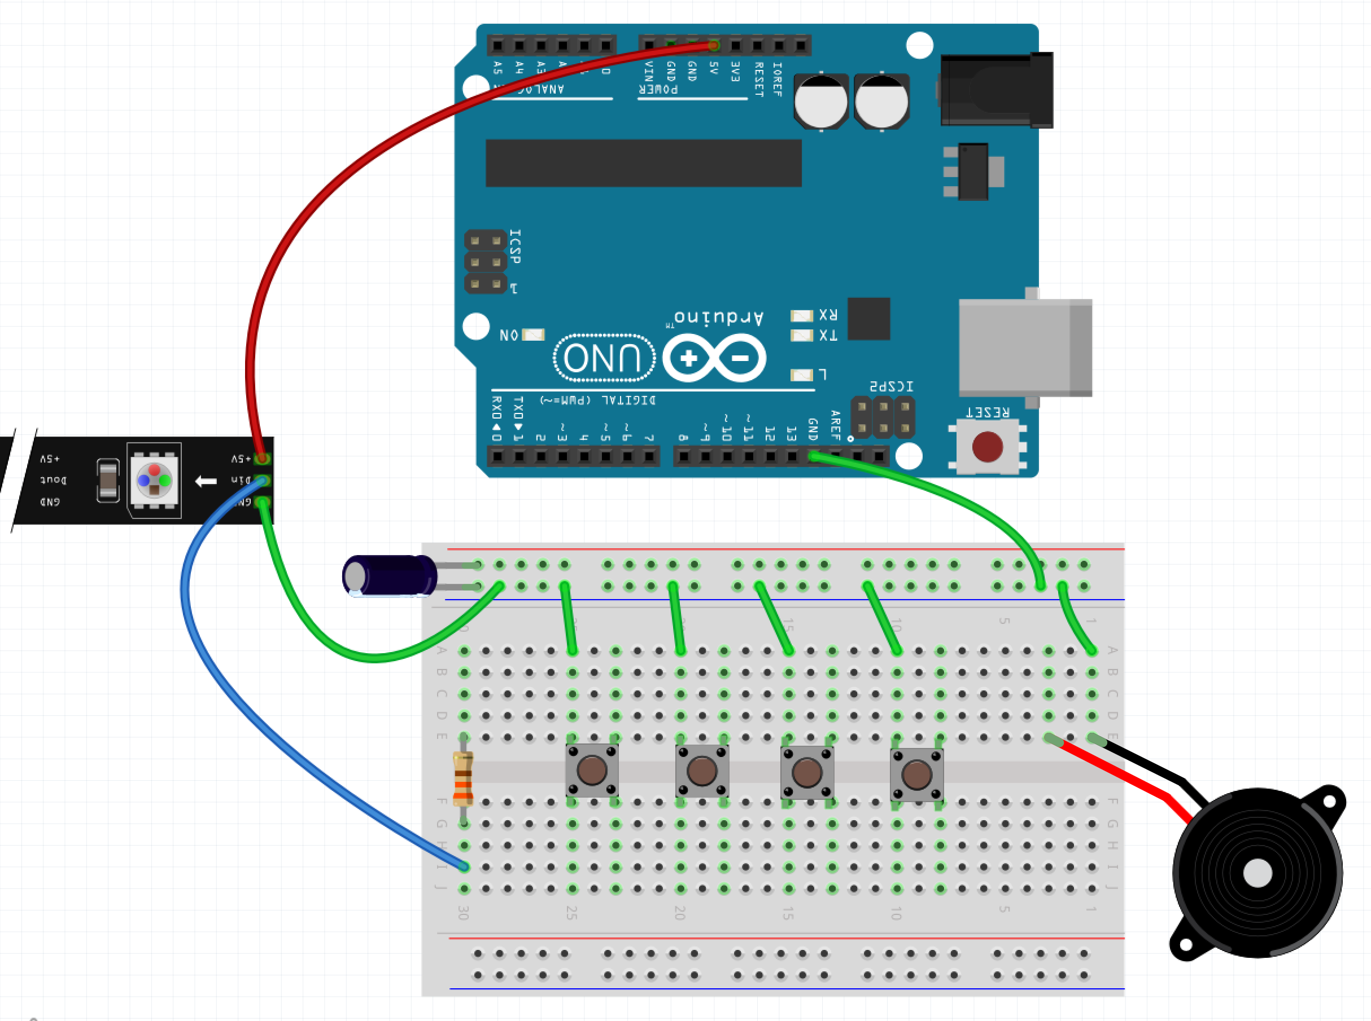
Step 4 – Run the Ground Wires
Run a wire from GND on the lower row of the Arduino to anywhere in the top blue row
Attach the female end of a female-male wire onto the GND pin of the WS2811 – place the male end into anywhere on the top blue row
Run 5 wires from anywhere on the top blue row to A:25, A:20, A:15, A:10, and A:1

Slide 15
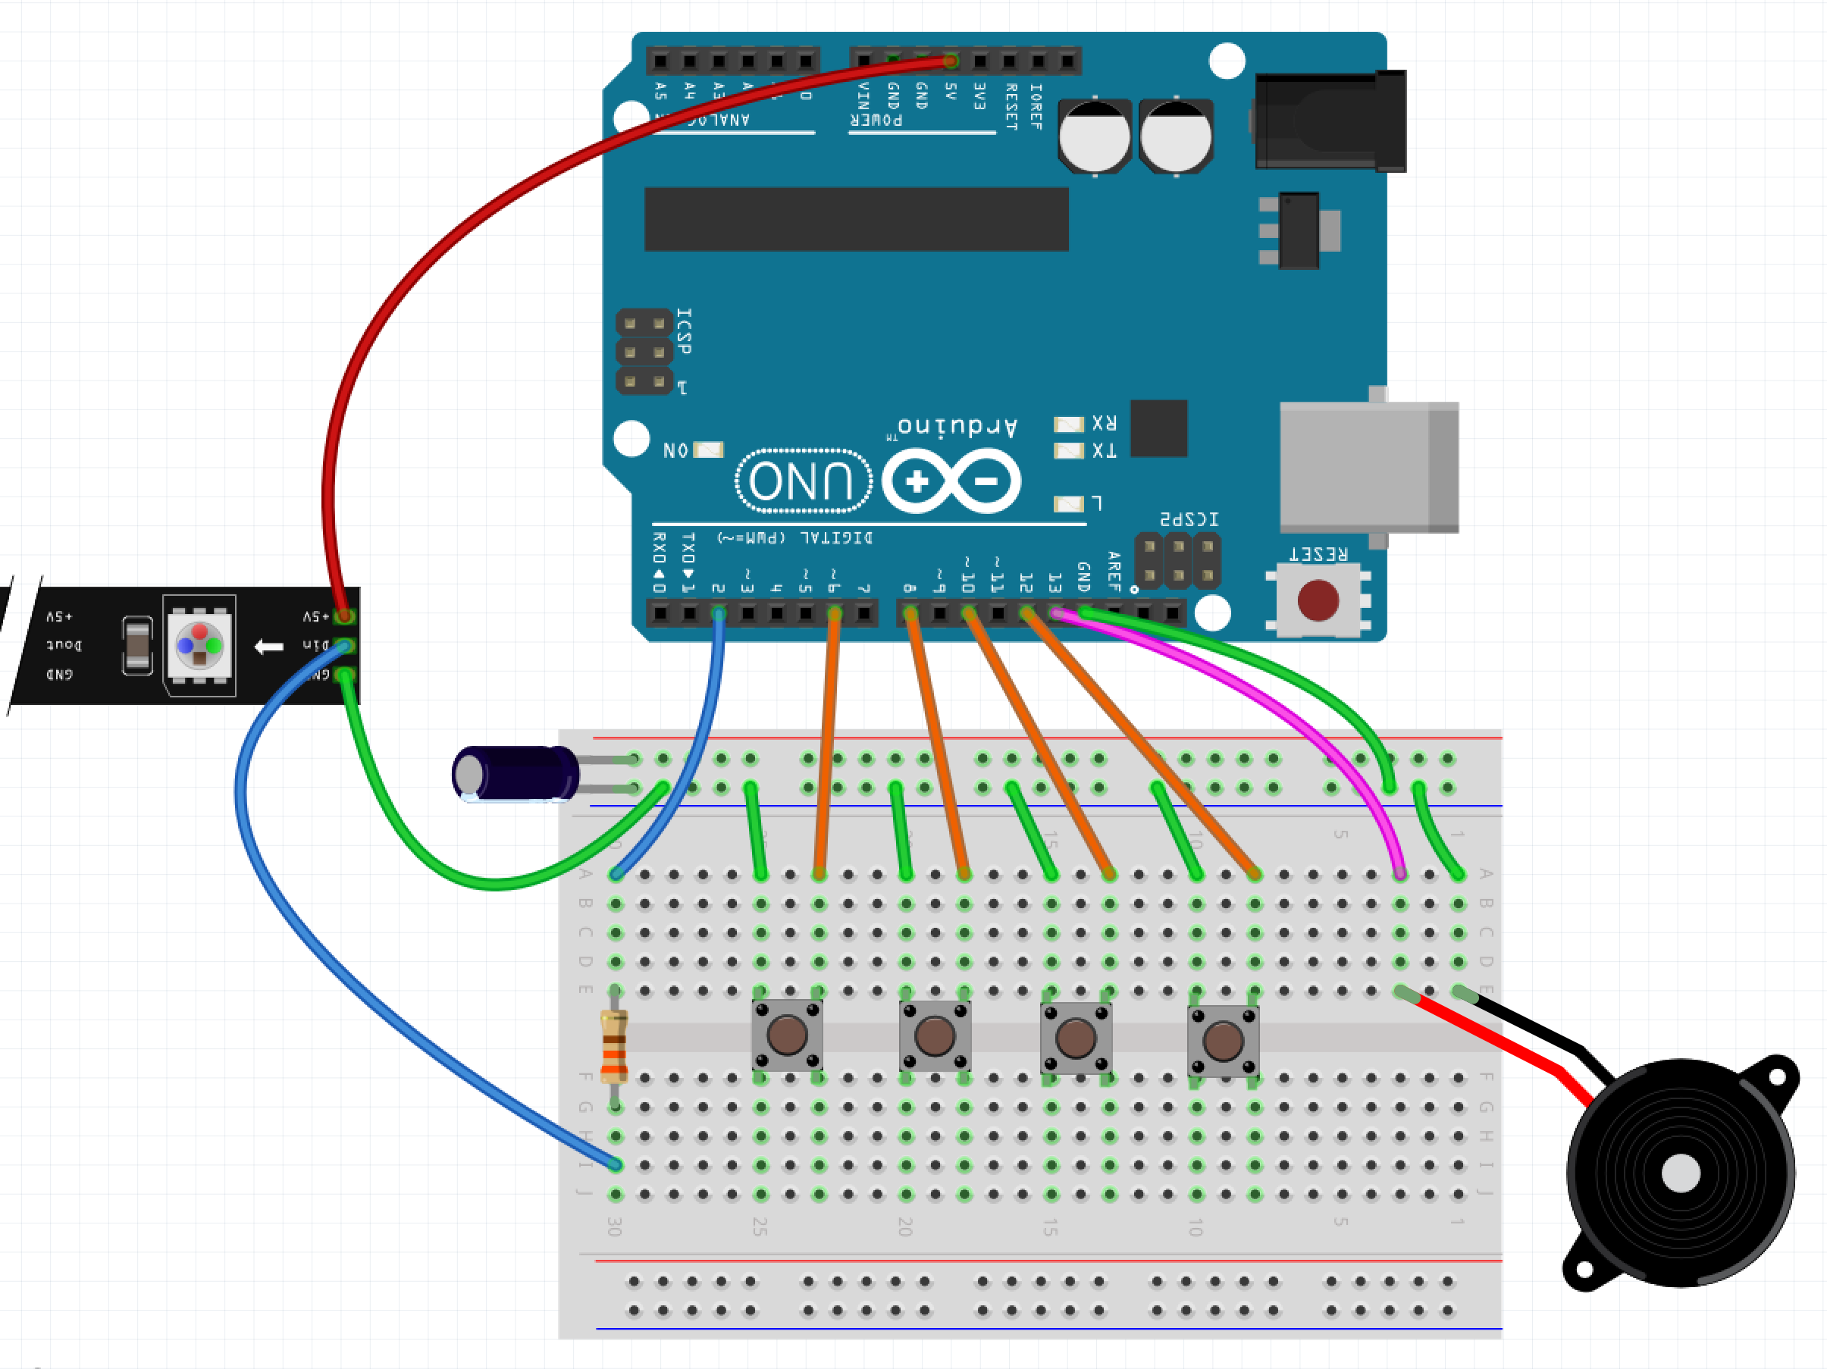
Step 5 – Run the Data Lines
Run a wire from pin 2 on the Arduino to A:30 (blue wire in diagram)
Run a wire from pin 6 on the Arduino to A:23 (orange wire in diagram)
Run a wire from pin 8 on the Arduino to A:18 (orange wire in diagram)
Run a wire from pin 10 on the Arduino to A:13 (orange wire in diagram)
Run a wire from pin 12 on the Arduino to A:8 (orange wire in diagram)
Run a wire from pin 13 on the Arduino to A:3 (magenta wire in diagram)

Slide 16
Step 5 – Power on the Arduino
Plug the Arduino into the USB Cable
Plug the USB Cable into the PC

Slide 17
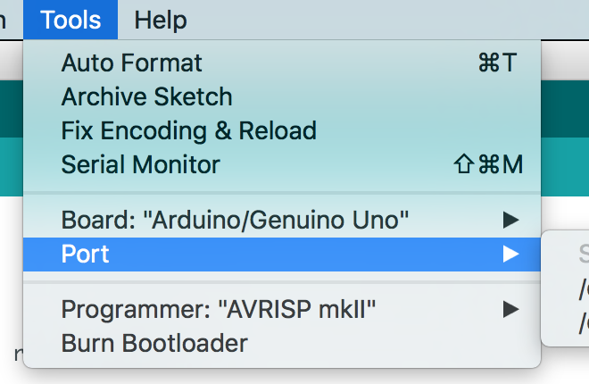
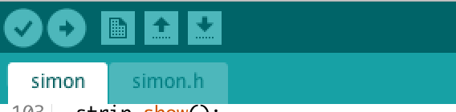
Step 6 – Program the Arduino
Plug the board into the PC via the USB plug
Open Sketch simon_step_01.ino in the simon_step_01 directory/folder
Select Tools -> Port
Click the Upload Button

Slide 18
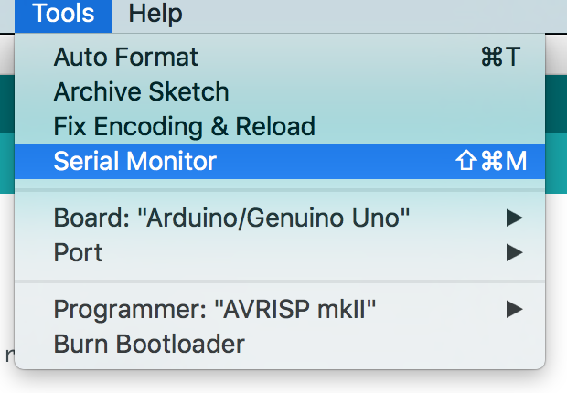
Step 7 – Open the Serial Monitor
Go to Tools and select ‘Serial Monitor’

Slide 19
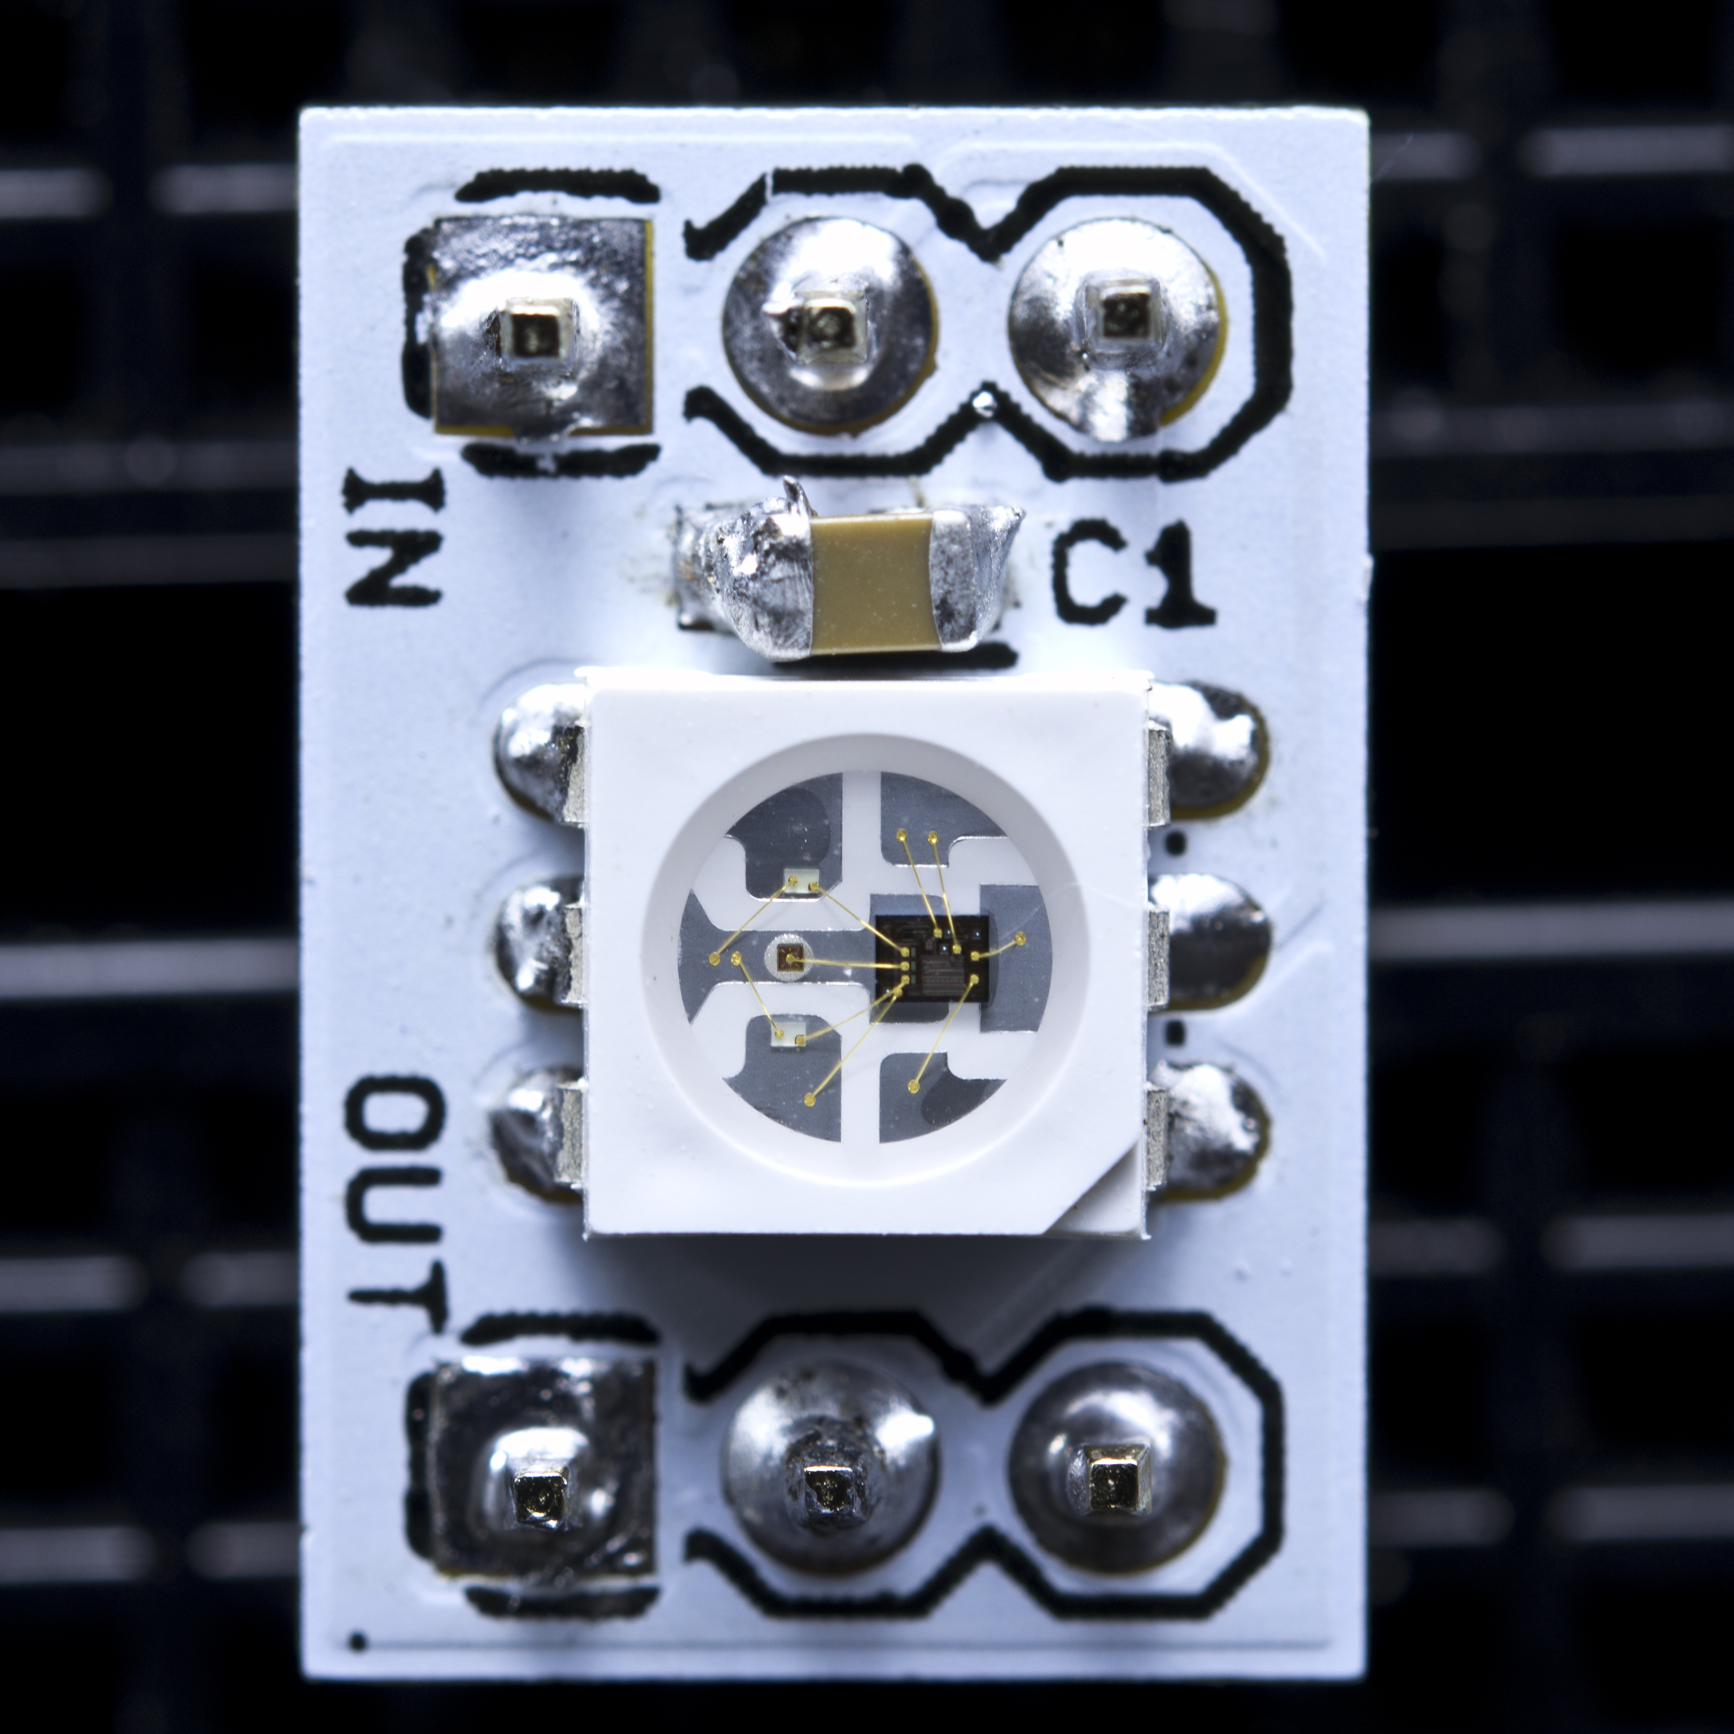
WS2811

Slide 20

Button as a Switch

Slide 21
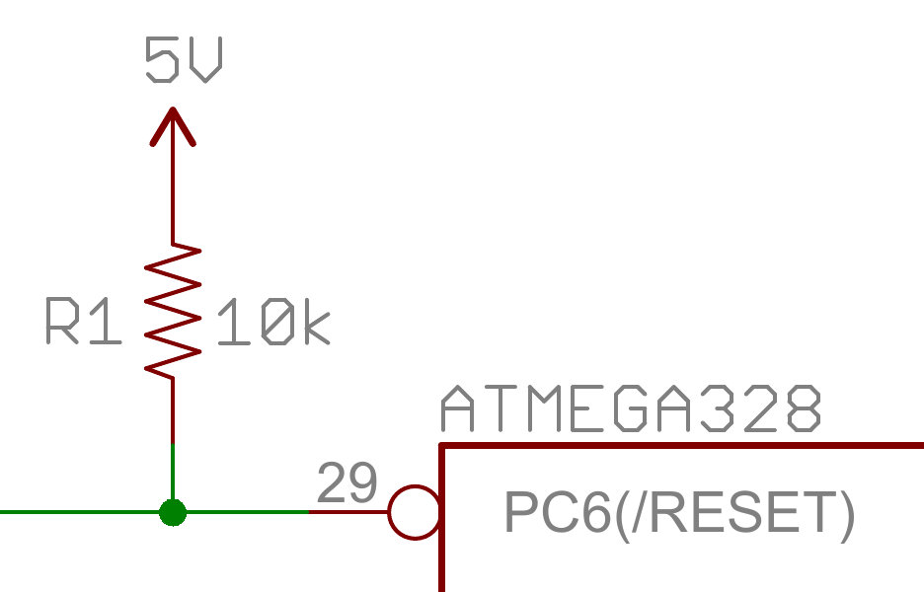
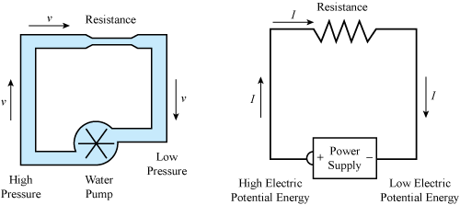
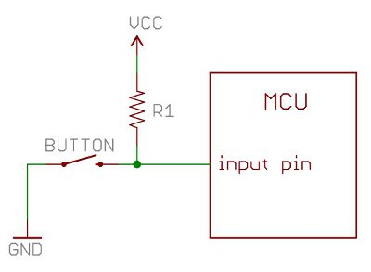
Resistors and Pull Up Resistors

Slide 22
Simon Step 1

Slide 23
Program the Arduino
Plug the board into the PC via the USB plug
Open Sketch simon_step_02.ino in the simon_step_02 directory/folder
Select Tools -> Port
Click the Upload Button

Slide 24
Simon Step 2

Slide 25
Program the Arduino
Plug the board into the PC via the USB plug
Open Sketch simon_step_03.ino in the simon_step_03 directory/folder
Select Tools -> Port
Click the Upload Button

Slide 26
Simon Step 3

Slide 27
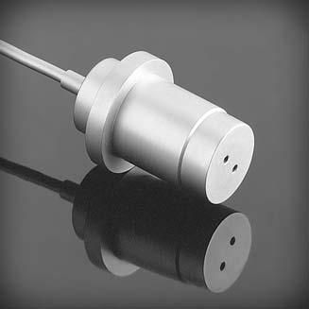
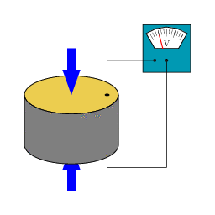
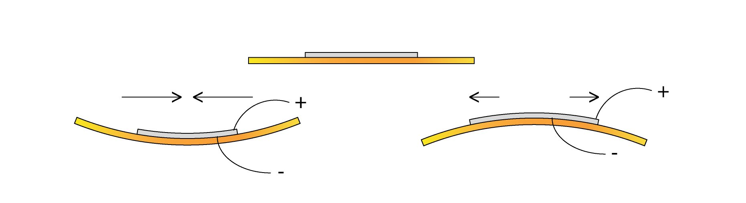
Piezoelectric Components

Slide 28
Program the Arduino
Plug the board into the PC via the USB plug
Open Sketch simon_step_04.ino in the simon_step_04 directory/folder
Select Tools -> Port
Click the Upload Button

Slide 29
Simon Step 4

Slide 30
Program the Arduino
Plug the board into the PC via the USB plug
Open Sketch simon_step_05.ino in the simon_step_05 directory/folder
Select Tools -> Port
Click the Upload Button

Slide 31
Simon Step 5

